Slide 1
Binary Prediction of Poisonous Mushrooms
Abheesht Roy, Aryan Gonsalves, Animesh Kumar, Varun Parekh
CSE-572
Checkpoint 1

Slide 2
Project Pitch Recap
Problem: Predict whether a mushroom is edible (e) or poisonous (p)
Motivation: Mushroom foraging is risky, visual ID unreliable, important for safety & education
Data: Kaggle Playground synthetic mushroom dataset
Task: Supervised binary classification
Evaluation Metric: Matthews Correlation Coefficient (MCC)
Planned Pipeline: preprocessing → baseline models → advanced models → evaluation & selection

Slide 3

Why It Matters
Health & Safety: Eating poisonous mushrooms can be fatal.
Unreliable Visual ID: Even experts often misidentify mushrooms.
Educational Value: Classic dataset for binary classification.
Data Mining Practice: Realistic high-stakes classification task.

Slide 4
Dataset Exploration and Visualization
Size: 3.1M rows × 22 columns
Target: class (balanced: ~55% edible, 45% poisonous)
Features: numeric (cap-diameter, stem-height, stem-width) + categorical (cap-shape, color, habitat, etc.)
Missing data: several features with >80% missing (veil-type, spore-print-color, stem-root)

Slide 5
Feature Types
Numeric Features (3)
cap-diameter, stem-height, stem-width
Categorical Features (14+)
cap-shape, cap-surface, cap-color, gill-attachment, gill-color, habitat, season, etc.
High-missing features (3)
veil-type, spore-print-color, stem-root

Slide 6
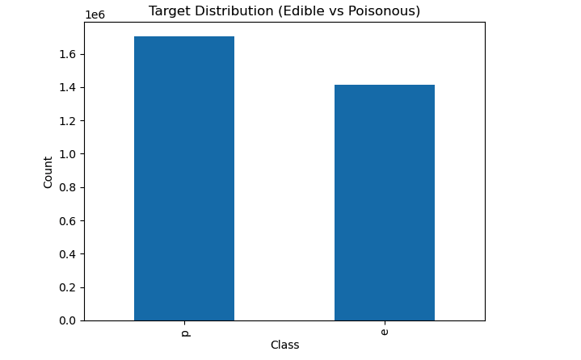
Target Distribution
Target is fairly balanced.
Edible (e) ≈ 1.7M; Poisonous (p) ≈ 1.4M.
No strong imbalance → models won’t be biased by class frequency.

Slide 7
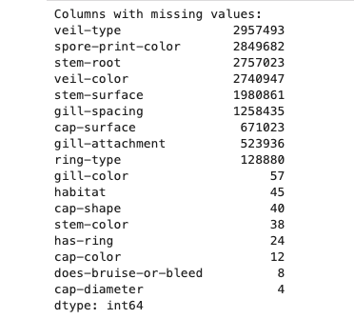
Missing values Analysis
Top columns with missing values:
veil-type → 95% missing
spore-print-color → 91% missing
stem-root → 88% missing
veil-color → 87% missing
gill-spacing → 40% missing
Takeaway:
Several features have too many gaps → candidates for removal.
Others may need imputation (mode/median).

Slide 8
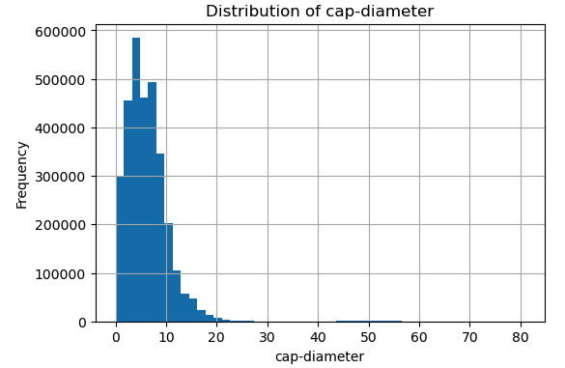
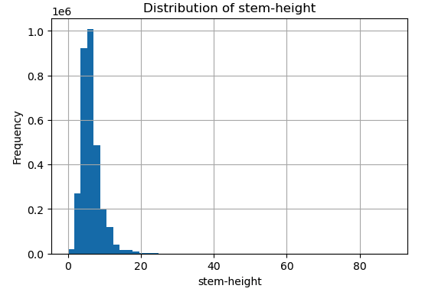
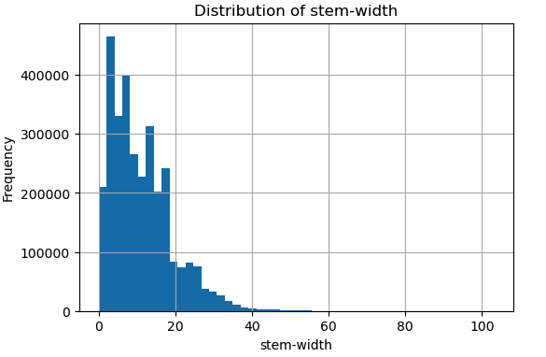
Numeric Features
Three numeric features: cap-diameter, stem-height, stem-width.
All are right-skewed (long tail with large values).
Outliers present (extremely large caps and stems).
Implication: scaling or robust models needed.

Slide 9
Numeric Features
Stem-height: right-skewed, outliers up to ~80.
Stem-width: mostly <15, but extreme outliers up to ~100.
Both features contain long-tail distributions.

Slide 10
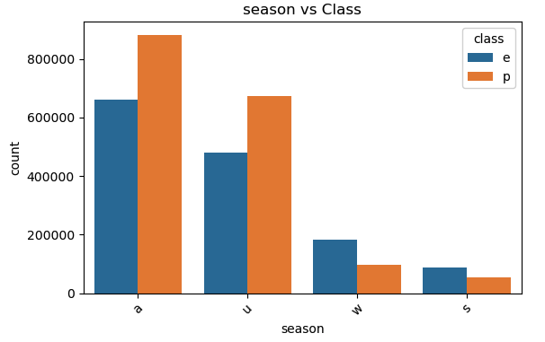
Categorical Features
Features are mostly categorical, letter-encoded (e.g., cap-shape=f, cap-color=n).
Observations:
Strong imbalances (e.g., cap-color dominated by “n”).
Missing values in cap-surface (~21%) and gill-attachment (~17%).
Some redundant/low-value features (veil-type, veil-color).
Key point: need encoding + imputation before modeling.

Slide 11
Categorical Example
cap-color distribution dominated by category n (~1.35M).
Other values much smaller (y, w, g, etc.).
Strong imbalance may reduce usefulness of this feature.

Slide 12
Summary of EDA So Far
Large dataset, balanced classes.
Numeric features are skewed with outliers.
Categorical features imbalanced, many single-letter encodings.
Several columns with high missingness (>80%).
Dataset is ready for preprocessing & baseline model development next.

Slide 13
Preliminary System Development
Preprocessing pipeline:
Dropped columns with >80% missing: veil-type, spore-print-color, stem-root.
Target mapped: e → 0 (edible), p → 1 (poisonous).
Separated categorical (14) and numeric (3) features.
Imputation: mode for categorical, median for numeric.
Encoding: OneHot for categorical features.
Baseline models trained on a 100k sample subset (for faster experimentation).

Slide 14
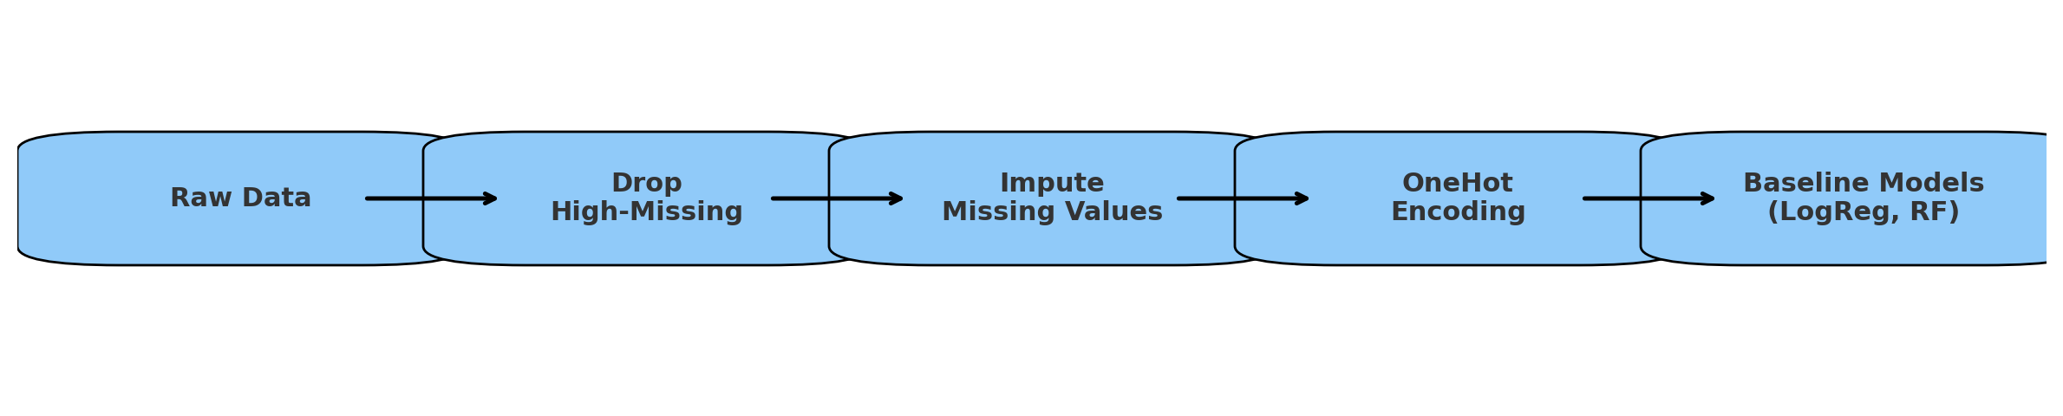
Modeling Pipeline Diagram
Drop high-missing columns.
Impute missing values (mode / median).
Encode categorical features (OneHot).
Train baseline models.

Slide 15
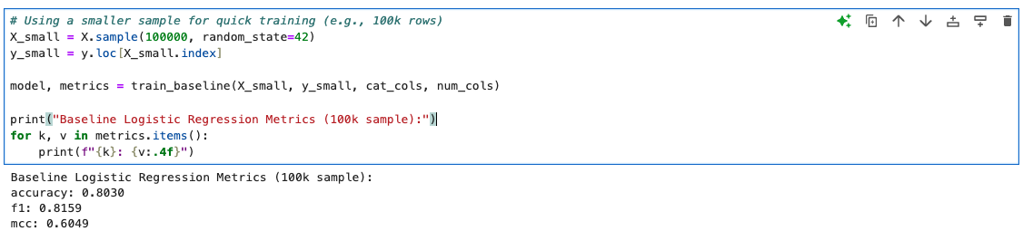
Baseline Results: Logistic Regression
Trained Logistic Regression on 100k sampled rows.
Results (Validation):
Accuracy: 0.803
F1 Score: 0.816
MCC: 0.605
Observations:
Decent baseline performance.
Training slow due to large one-hot encoding.
Convergence warning → more iterations or scaling needed.

Slide 16
Baseline Results: Random Forest
Trained Random Forest on same 100k sampled rows.
Results (Validation):
Accuracy: 0.99
F1 Score: 0.99
MCC: 0.98
Observations:
Substantially better than Logistic Regression.
Handles categorical features more effectively.
Caution: may overfit synthetic dataset → need further validation.

Slide 17
Results Comparison (LogReg vs RF)
Logistic Regression → 80% accuracy, MCC 0.60.
Random Forest → 99% accuracy, MCC 0.98.
RF shows much stronger performance but may overfit synthetic dataset.

Slide 18
Analysis & Future Plans
Limitations so far:
Logistic Regression struggles with high-dimensional one-hot features.
Random Forest strong but risk of overfitting.
Only sampled 100k rows — full dataset (3.1M) not yet used.
Plans for next checkpoint:
Scale up to full dataset.
Try Gradient Boosted Trees (XGBoost, LightGBM).
Perform hyperparameter tuning.
Introduce cross-validation for robust results.
Final project goal:
Build a scalable, high-performing classifier with MCC as the key metric.

Slide 19

Closing slide

